Slide 1
Automating Training Feedback Collection: A Systems Engineering Approach
Taylor Ribeiro
February 2025
Notes:
Hello everyone, my name is Taylor Ribeiro and I am here today to present one of my recent projects “automating Training feedback collection”. I work with software in my current role so you will notice that its more software based. It is an interesting project that I enjoyed working on and something that I am proud to share that I completed on my own, from start to finish.

Slide 2

Introduction
Expertise:
Data Analytics & Data Engineering
User-Centric Design & User Research
Product Owner leading software design and technical enablement for over 5 years
Architecture, Design, Integration, and Verification & Validation of large, complex defense systems
Bachelors in Mathematics, Business Statistics – UMASS Lowell (2014)
Masters in Systems Engineering – George Washington University (2022)
Taylor Ribeiro
Notes:
Before we get into the project, some of you have already met me but I realize some of you will be meeting me for the first time today so here is a bit about my background. Data Analytics and Data Engineering, user-centricity. From a pure systems engineering perspective, I have experience across the entire Systems Engineering “V”, working with large, complex defense systems. In addition, I have over 5 years of experience as a product owner in a Scaled Agile environment, leading software development and technical enablement.

Slide 3
Background & Agenda
Agenda:
Project Overview & Problem Statement
Systems Engineering Approach
Solution Implementation
Results & Lessons Learned
Q&A
How I took a Systems Engineering approach to building an end-to-end automated data solution
Notes:
Today, I will walk you through how I implemented and end-to-end data solution using the principals of systems engineering. We will go through the initial problem, how I approached it, how I implemented my solution, and what some of the outcomes were. Then we will have time at the end for Q&A.

Slide 4
Project Objective & Problem Statement
Training Program
16 Weeks of Webinars
80 Daily User Feedback Surveys
80 Resulting Excel Datasets
Problem:
Manual feedback collection → slow, error-prone.
Data Usability → trainers couldn’t visualize data or spot trends
Objective:
Ensure Anonymous feedback.
Automate training feedback collection.
Reduce manual effort.
Enable trainers to make data-driven decisions.
Notes:
My team is responsible for training and upskilling thousands of employees across our global company in the are of Data & AI. We collect feedback from our trainees regularly, to make improvements to our content and delivery. Last year, we held 16 weeks of webinars for one of our training programs, and we collected trainee feedback daily. With our old process, we would be left with over 80 excel files of data to parse through. This process was slow and error prone, and the resulting data was not user friendly. As a Data & AI organization, we needed to make more data-driven decisions.

Slide 5
Systems Engineering Approach
Breaking down the problem into key areas:
Requirements Definition
Stakeholder Engagement
Functional & Non-Functional Requirements
Architecture Design
Security & Scalability
Modularity
Implement, Integrate & Automate
Implement Solution
Manage Risks
Validation & Performance Monitoring
Ensure Security & Efficiency
Refinements

Slide 6
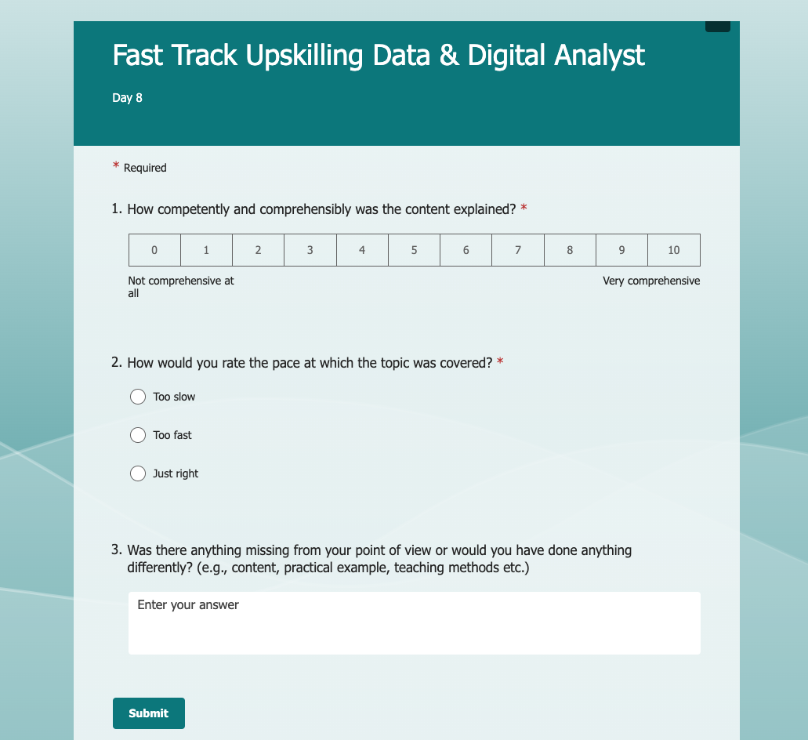
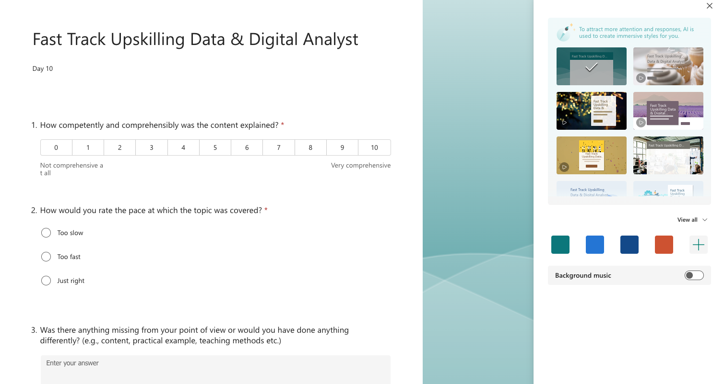
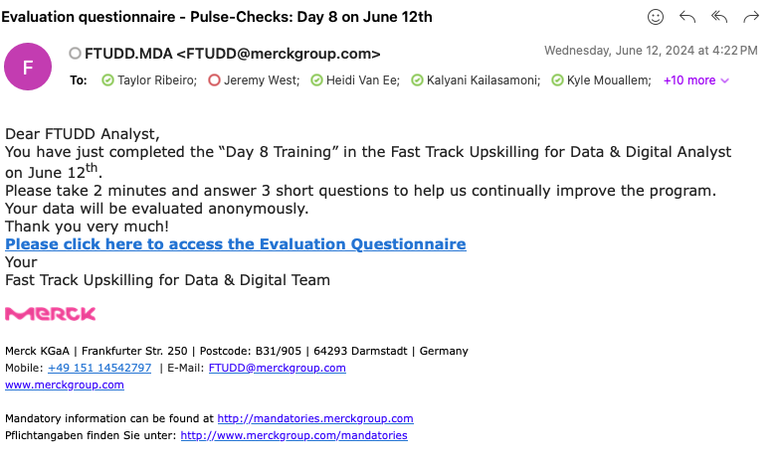
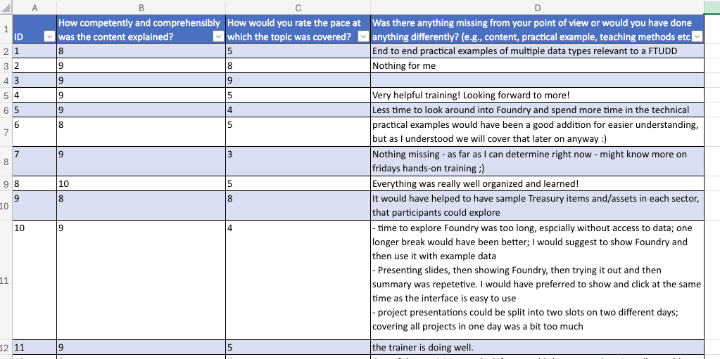
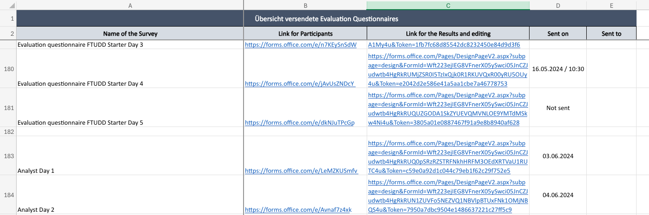
Old Process
Take Survey
Create MS Form
Send Email
Tabulate Results

Slide 7
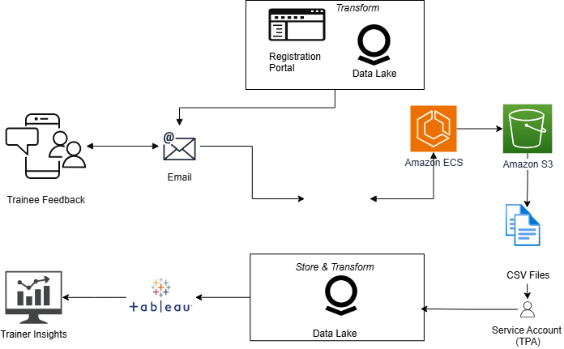

Solution Architecture
Step 1
Step 3
Step 2
Step 4

Slide 8
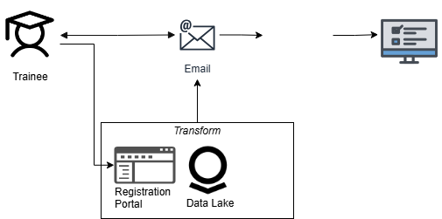
Automation
Step 2
Step 3
Step 1

Slide 9
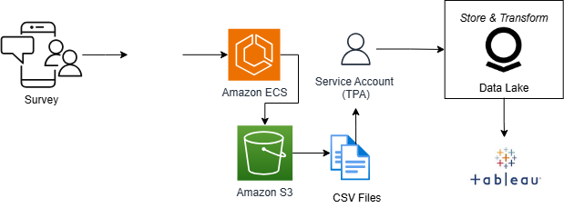
Data Pipeline
Step 2
Step 1

Slide 10
Risk Management
Risks:
Survey Downtime → AWS hosted and configured for high availability.
Data Integrity → Validation and health checks in the data pipeline
Security Concerns → Role-based Access control
Scope Changes → Modularity
Challenges:
Data Privacy Anonymity & Authentication → TPA to connect to Foundry.
Parsing issues → Update Schema.
Notes:
Issues came up during my project, and I found solutions to all of them.

Slide 11
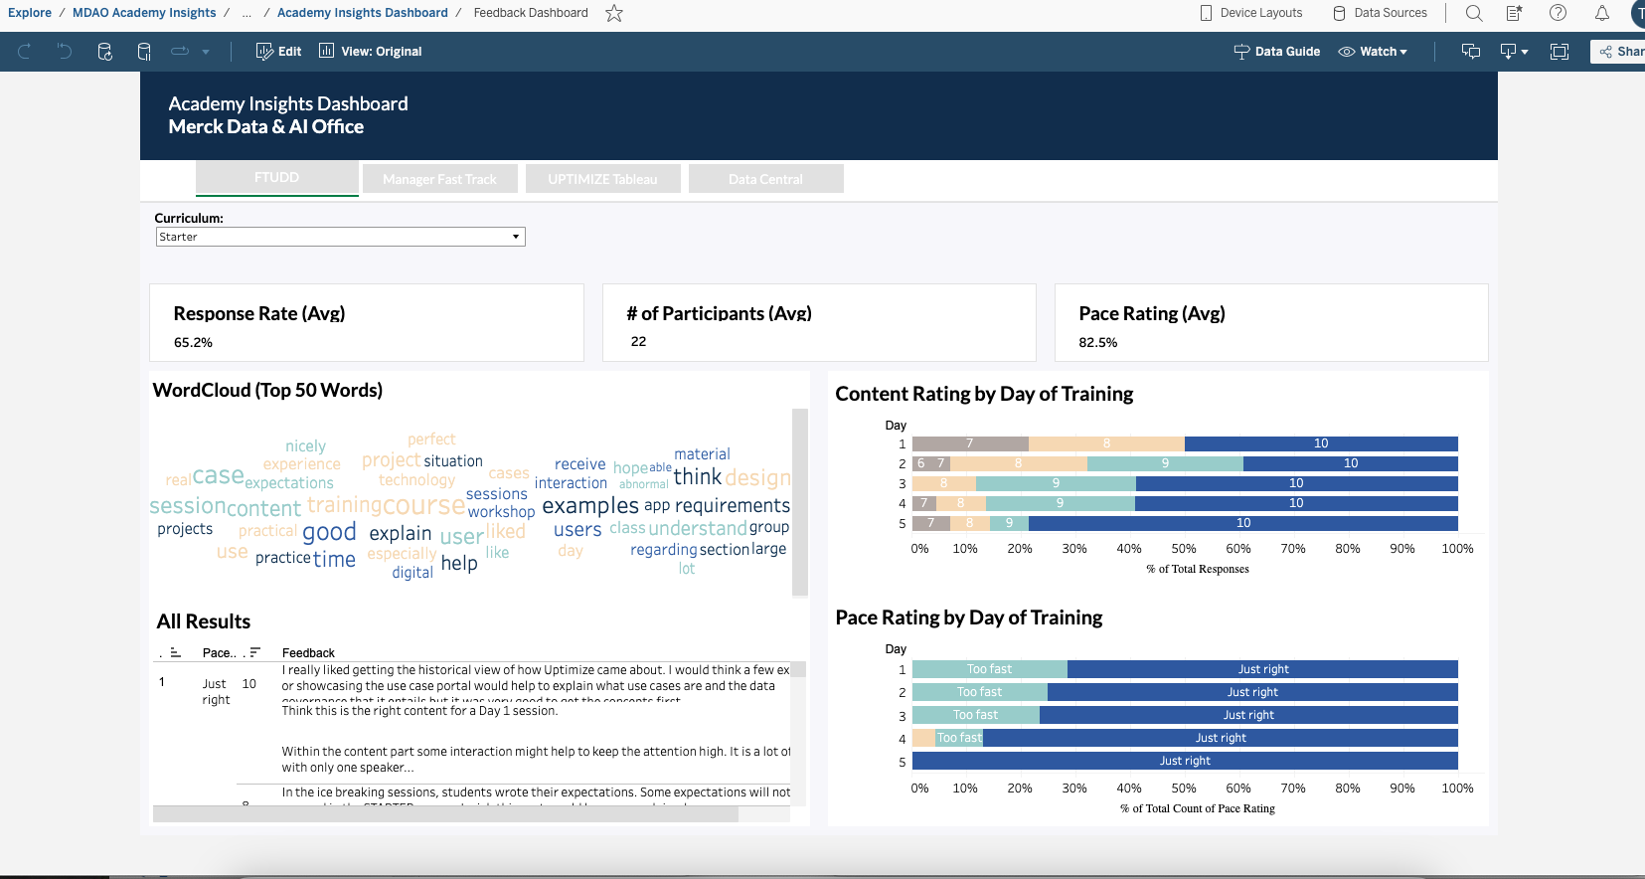
Results & Takeaways
Results:
Processed over 1,000 files in just under 50 seconds
Saved over 50 hours of manual effort
Reduced error by 20%
Extended to other training programs.
Key Takeaways:
Early stakeholder alignment promoted efficiencies in dashboard design.
Future Enhancements:
Schema governance.
Multi-language support for global users.
AI-based sentiment analysis to extract deeper insights.

Slide 12
Q&A

